Slide 1


EDA – Phase 1 Project 7: SVM default model + All features Random Forest default mode + All features Tableau/Power BI dashboard
Team 7
Sandaru Welikala
Juan Maya
Mario Palomino

Slide 2
Introduction
The objective of this project is to prepare clean data to predict if a patient will die or survive after 28 days in the intensive care unit, we are using public data MIMIC-IV to perform this exercise.
In the following report we will present the different steps to understand and clean the data of mimic iv. First we try to understood the variables after classifying them and visualize the data to identify distribution of row data. Then we check for the unique values in each variables and did identify the missing values. Lastly, we started to treat the missing values in the dataset.

Slide 3
What does data set contain?
We are working with mimic_iv and it contais
6037 observations
207 variables.
Mortality is TARGET variable.
Variables classification on the left.
In the data set there are 34 variables that contain more information.
Diagnosis and medical history has binary variables.

Slide 4
Variable Classification
63 Binary with just 1 value
34 key variables
This variables contain information for numerical and categorical format for statistics analysis.
Binara diagnosis are going to be more relevant for the model, there are 63 with a unique value, this variables do not provide much information.

Slide 5

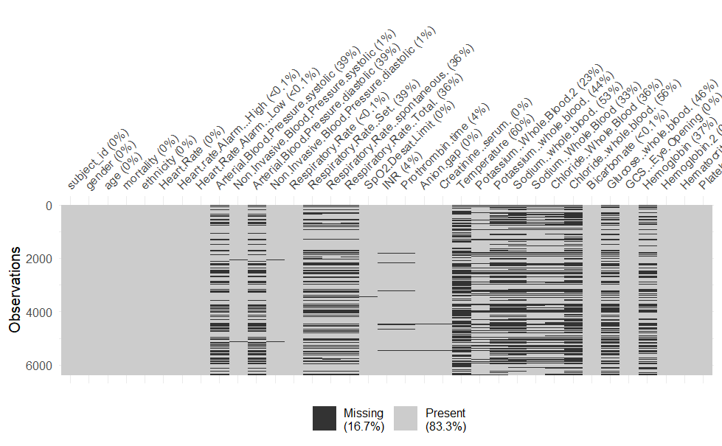
Which variables have missing values?
There are variables that have more than 30% of missing values, some of them are laboratory test that can’t be impute. (important features)
Other are going to be analyze to take a decision.

Slide 6
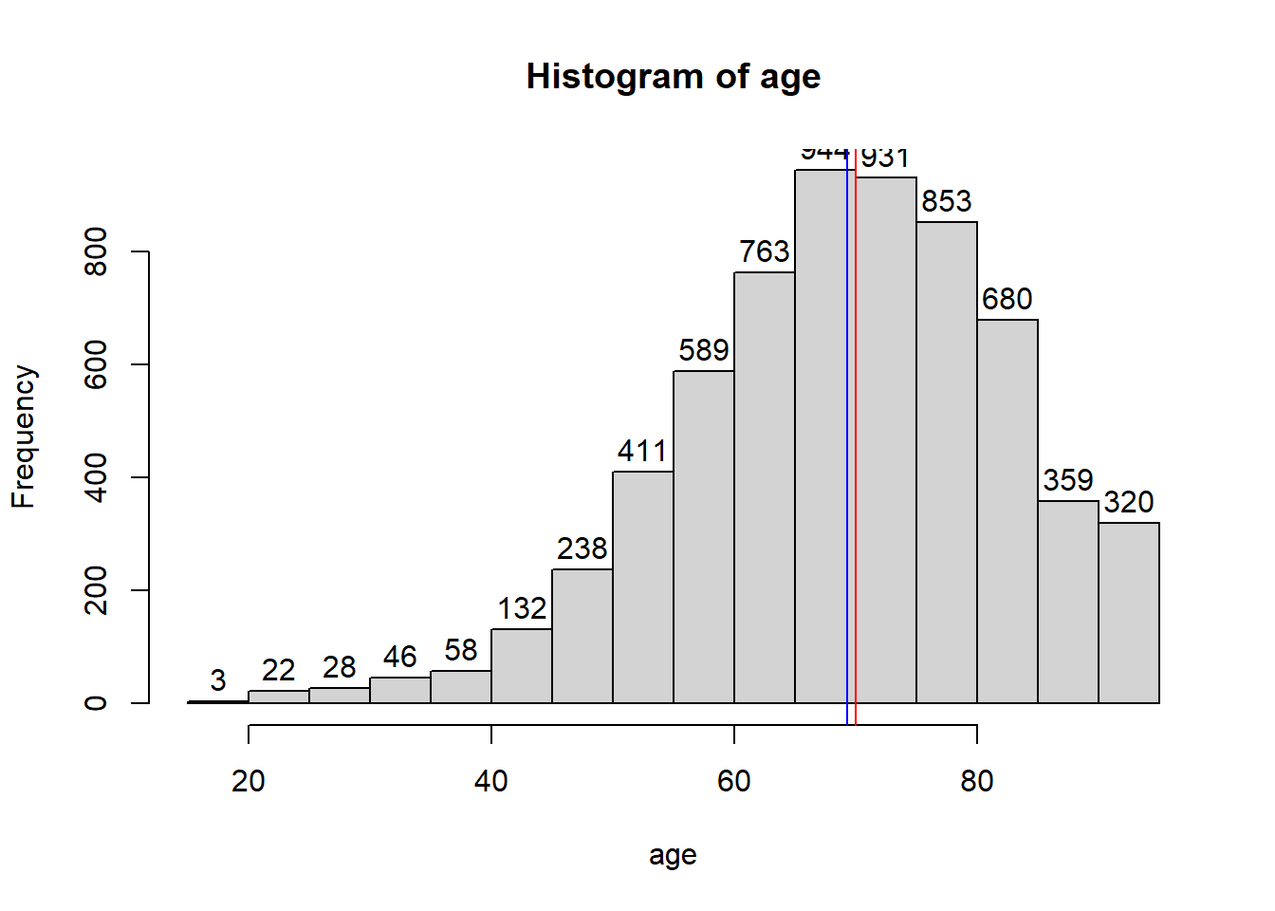
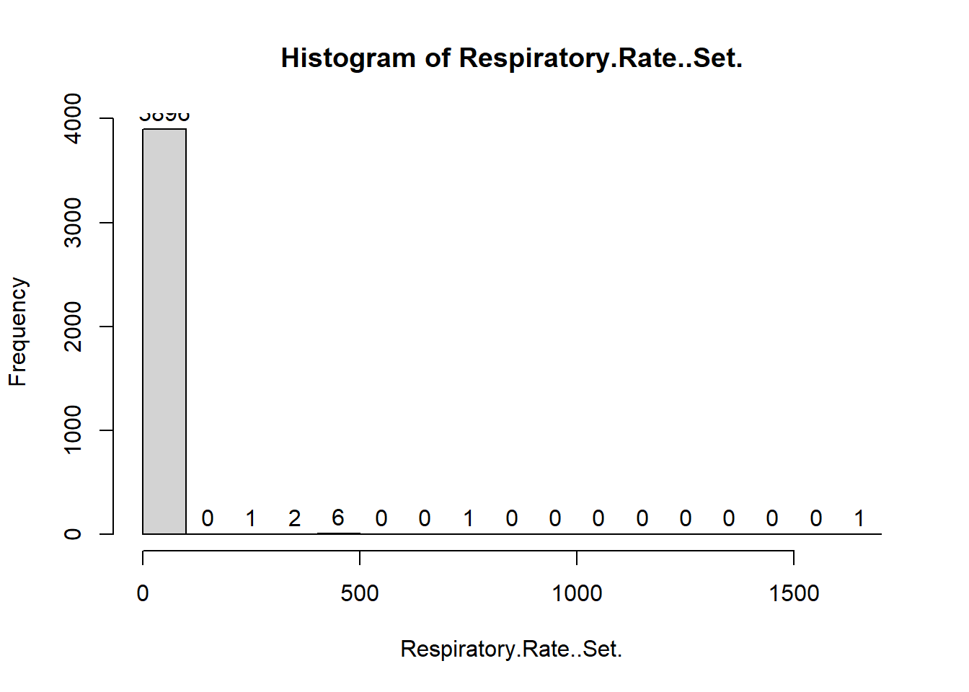
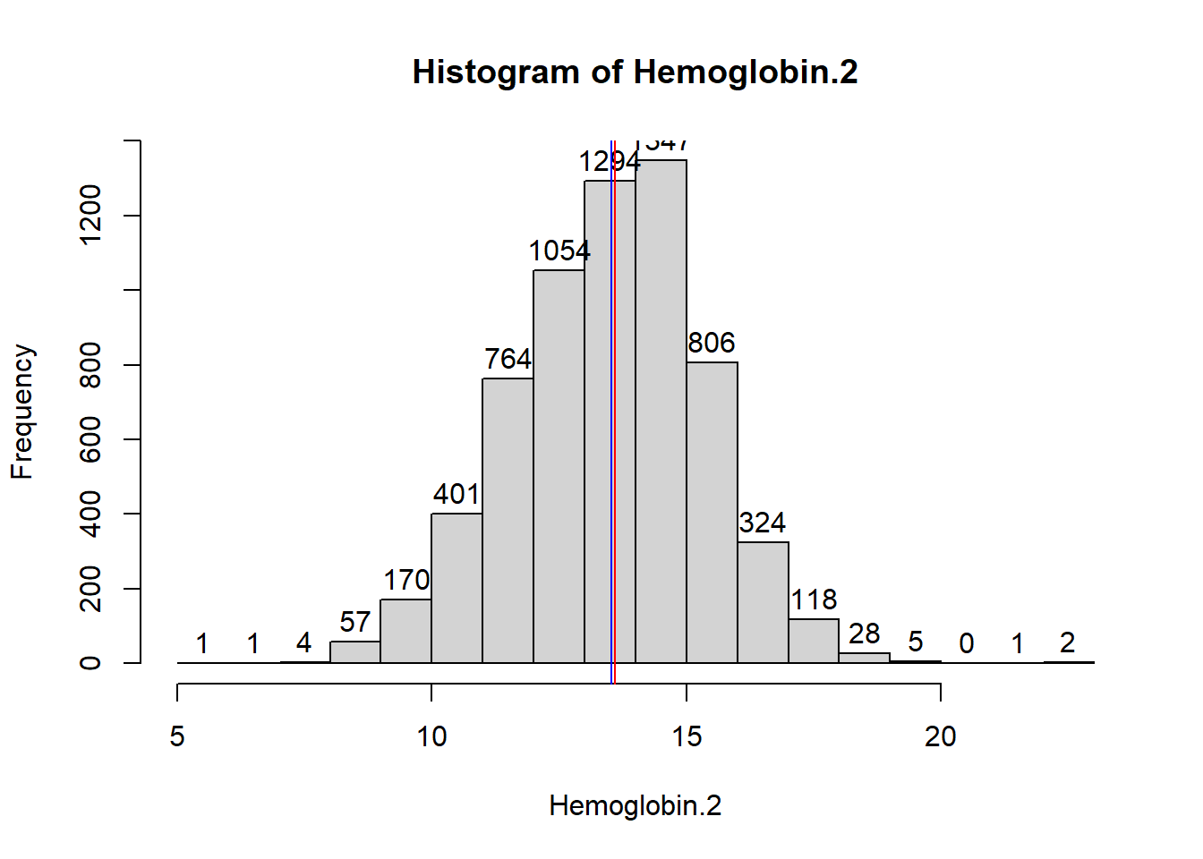
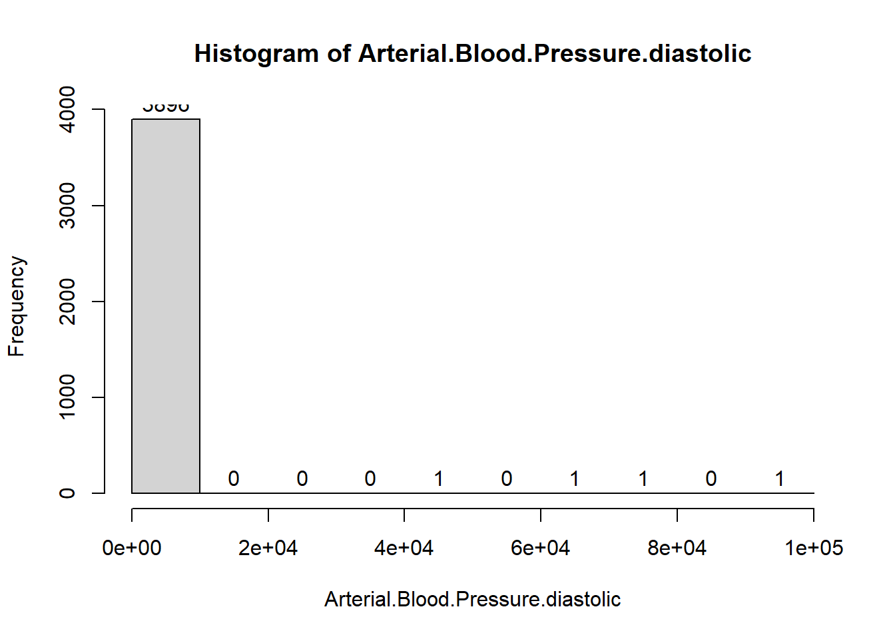
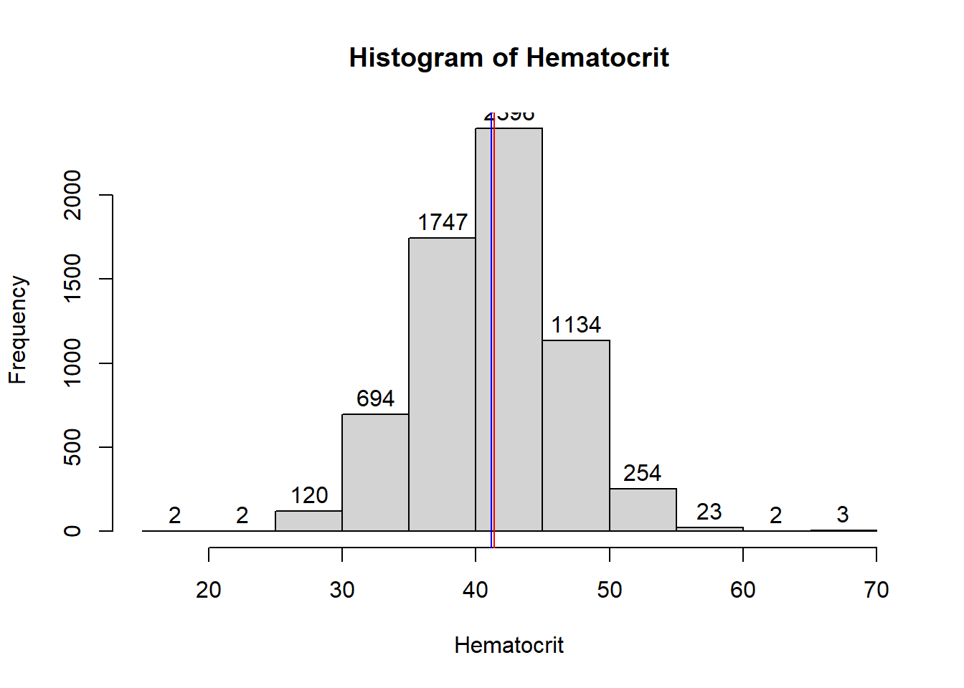
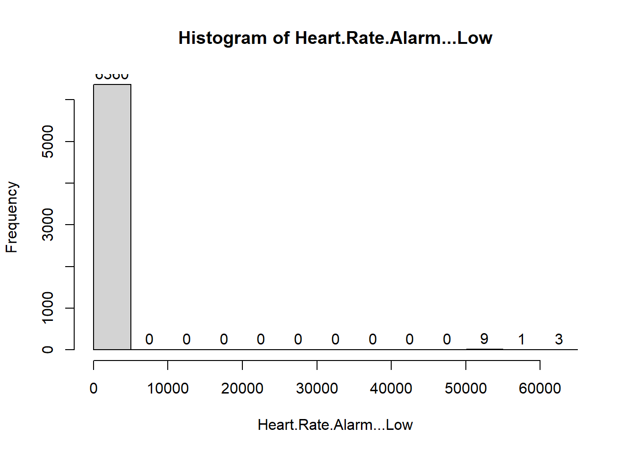
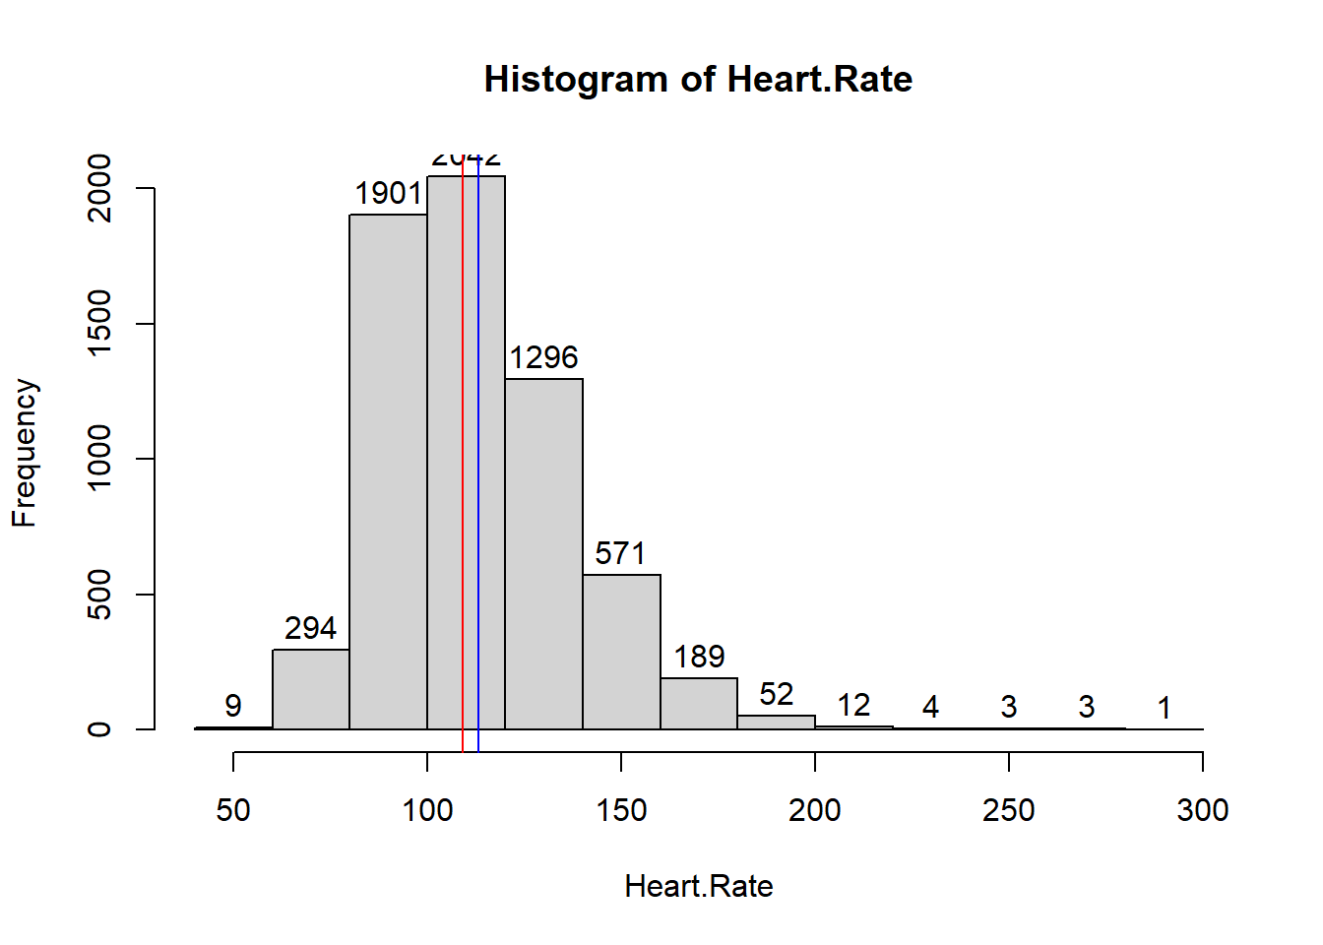
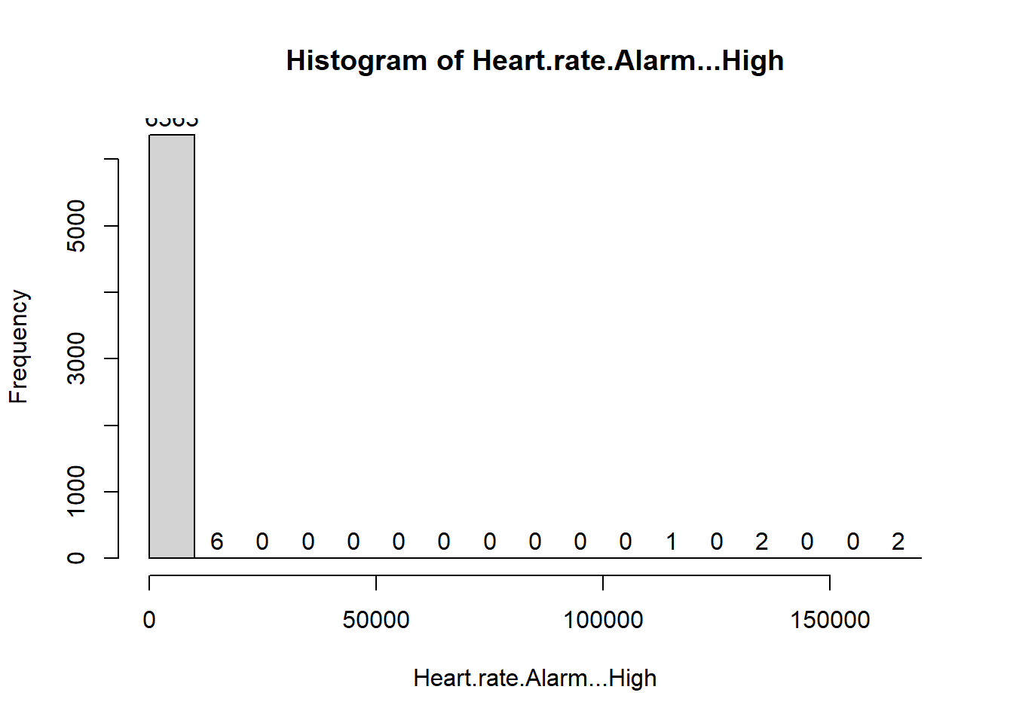
How does numerical variables look like?
One the other side there are variables with right skew chart, that shows error values or extrem :
Heart.rate.Alarm...High
Heart.Rate.Alarm...Low.
Arterial.Blood.Pressure.systolic.
Non.Invasive.Blood.Pressure.systolic\
Arterial.Blood.Pressure.diastolic
Non.Invasive.Blood.Pressure.diastolic
Respiratory.Rate
Respiratory.Rate..Set.
Respiratory.Rate..spontaneous.
Respiratory.Rate..Total.
SpO2.Desat.Limit
INR
Prothrombin.time
Anion.gap
Creatinine..serum.
Potassium..Whole.Blood.2
Potassium..whole.blood.
And others
There are Variables a distribution of values that aper to be correct:
age.
Heart rate.
Temprerture.
Sodium..Whole.Blood
Chloride..Whole.Blood
Bicarbonate
Hemoglobin.2
Hematocrit

Slide 7
Is there any error values in data?
From first data analysis we can see that besides missing values there are error values that will have to be remove.
As well, data that is out of rage.

Slide 8
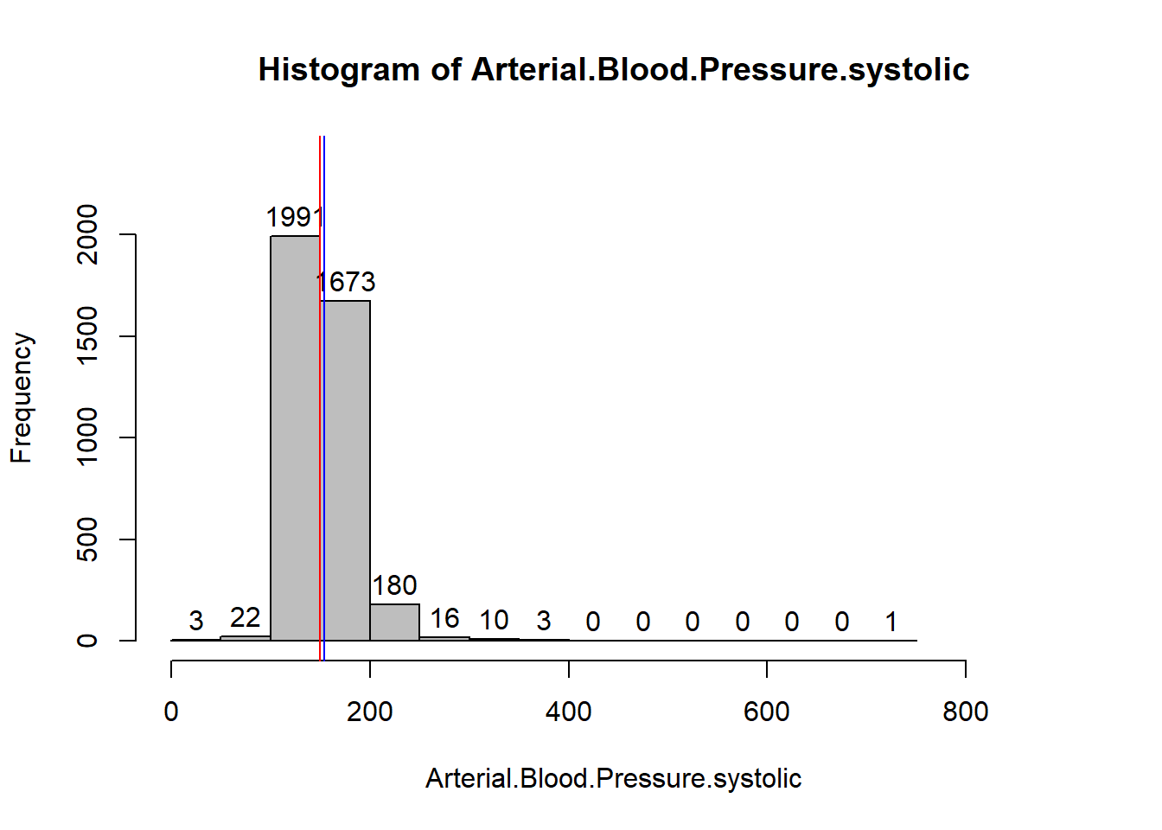
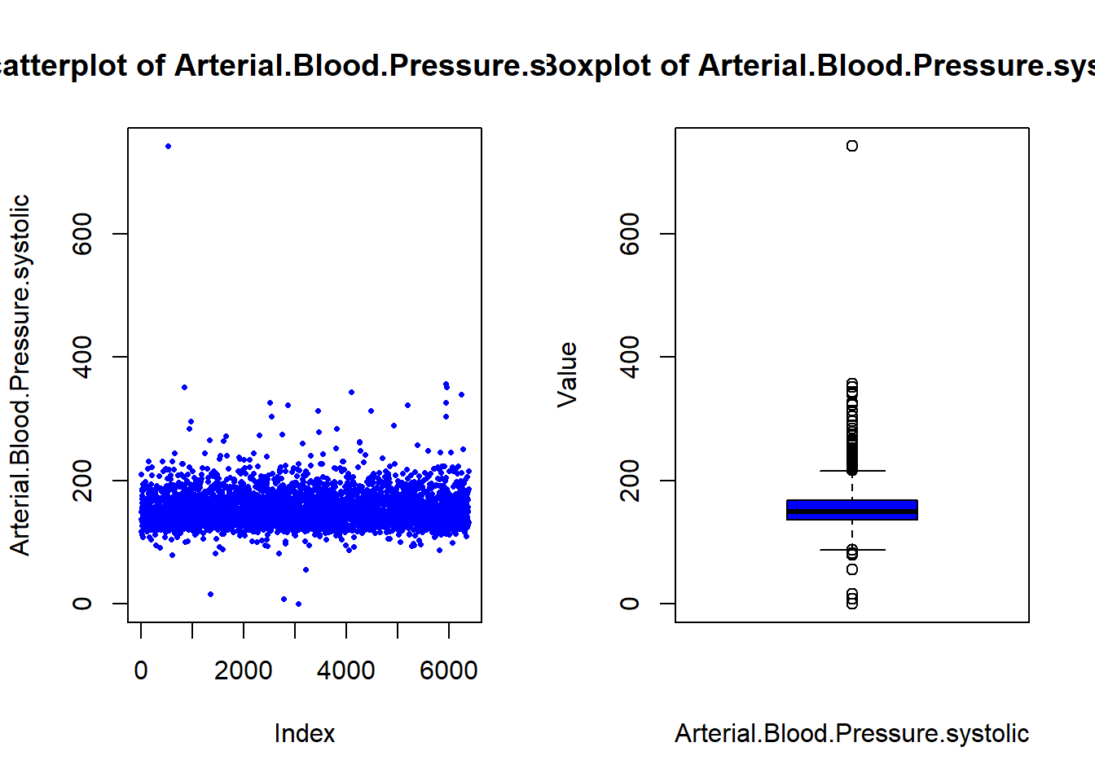
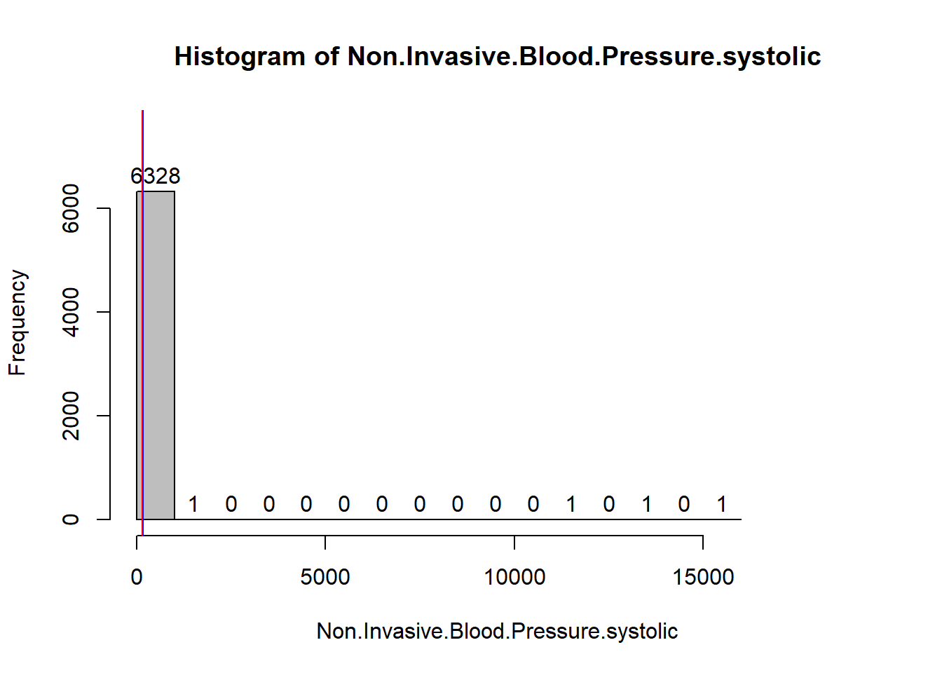
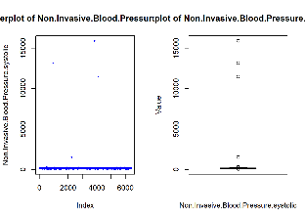
Which variables have value errors?
After analyzing with other visualizations for right-skewed histograms, we can confirm that some values are errors, and those errors are clearly separated from normal data, which we will address later.
On the right side are two examples of how these errors are detected. Error values are circled in red; the histogram is skewed due to these variables, the scatter plot appears flat, and the box plot clearly shows the outlier values.

Slide 9
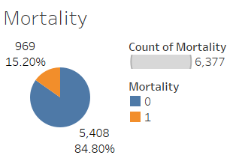
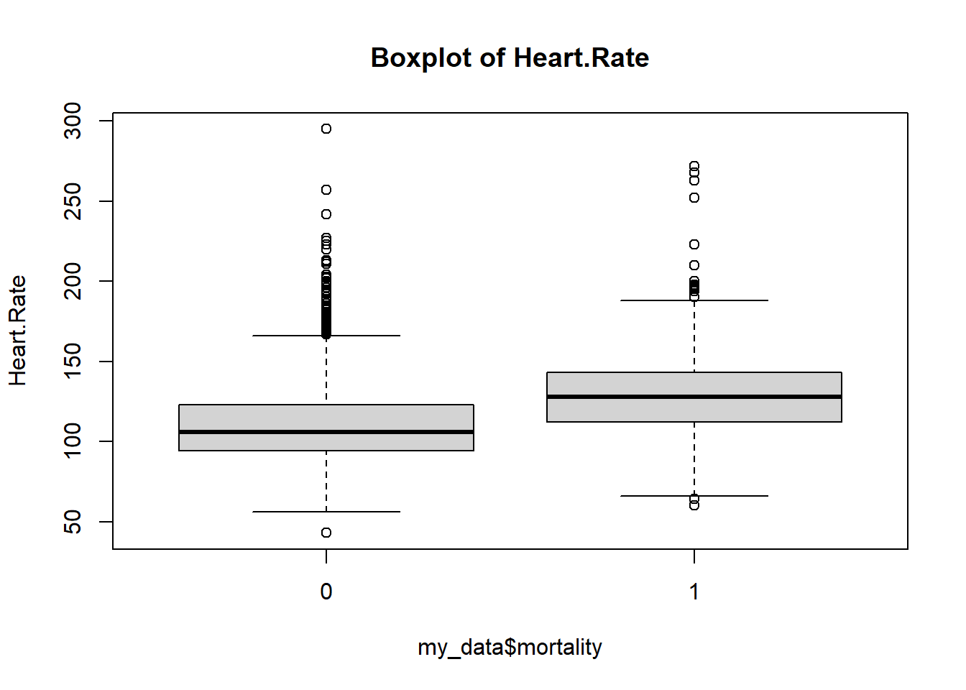
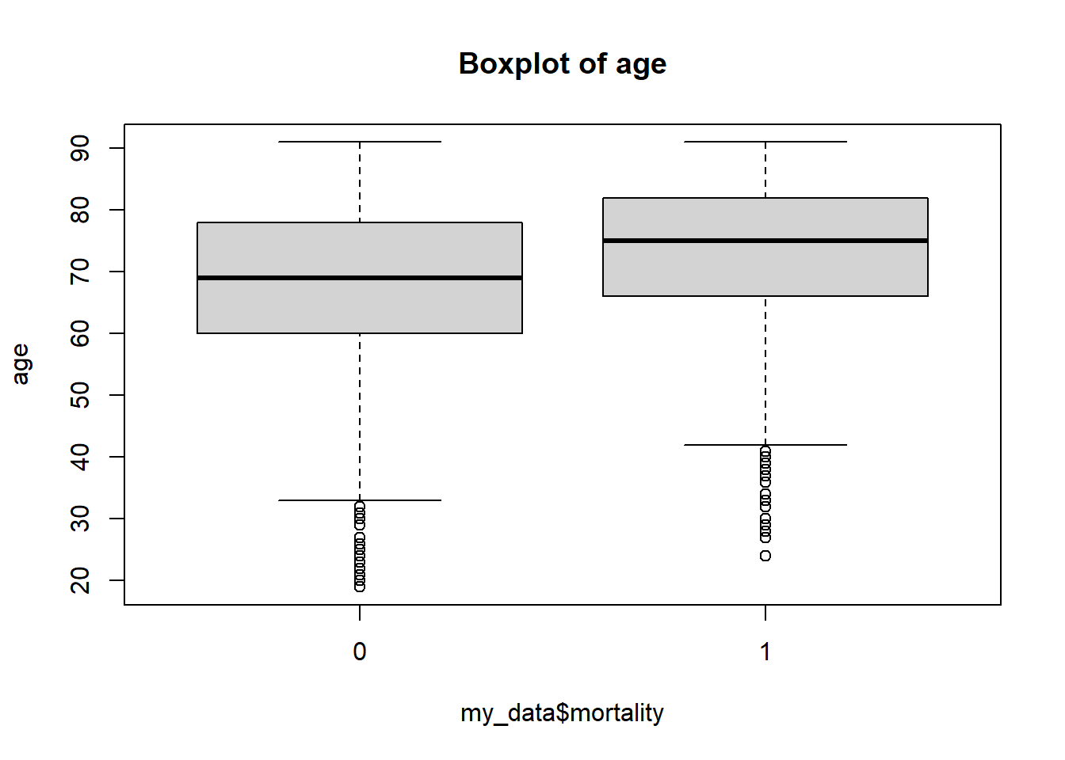
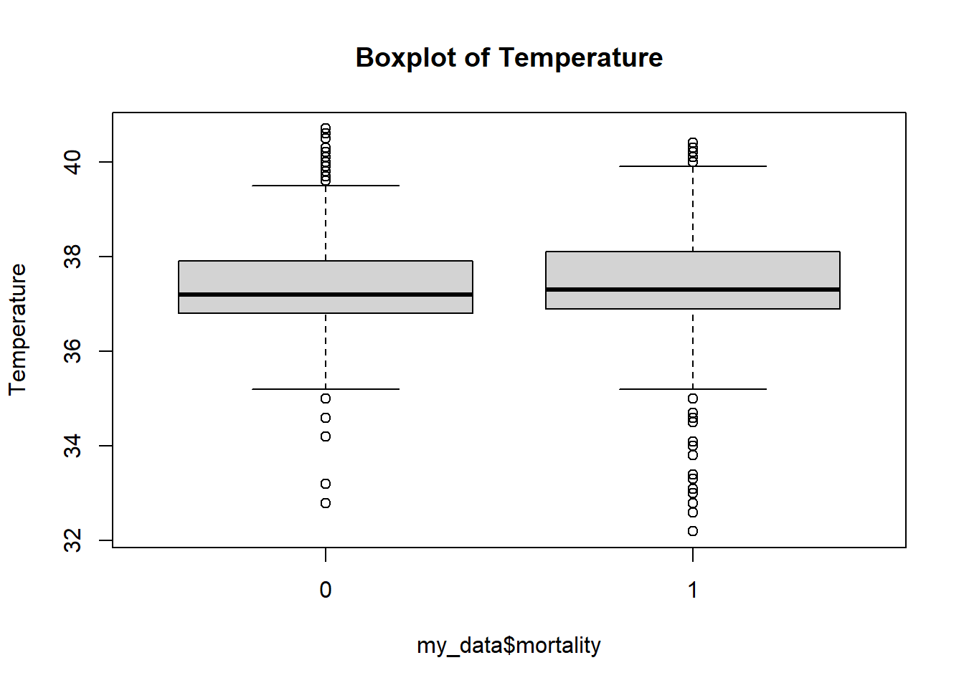
Is there difference behavior for mortality (survive / non-survive)?
Before cleaning, the data suggests that some variables may differ based on mortality, such as
Age,
Temperature, and
Heart Rate.
The target variable indicates whether patients survived or died after entering the ICU. In the initial population data, 15.2% of the sample died, while 84.8% survived.

Slide 10
How is the logic of our data cleaning process?
Raw Dataset
6377 obs
207 variables
NA's = 37341
Description of variables
Missing data assessment
Graphical review
Variables relationship review
PRE
Limiting ranges of Numerical variables
Valid ranges check
Theorical and practical setting
Distribution check
Visual override and adjustment
1
6377 obs
207 variables
NA's = 37683
2
Binary variables aggregation
Grouping by characteristic
Transformation from binary to a ranking
Minimizing amount of features
CLEANING DATASET
6377 obs
47 variables
NA's = 37683
Handling missing in Numerical variables
Combining variables by type
Comparing by key categorical variables
Age, Gender, Ethnicity
Imputation with statistical measurements
Median approach
3
Final Dataset
3406 obs
34 variables
NA's = 0

Slide 11
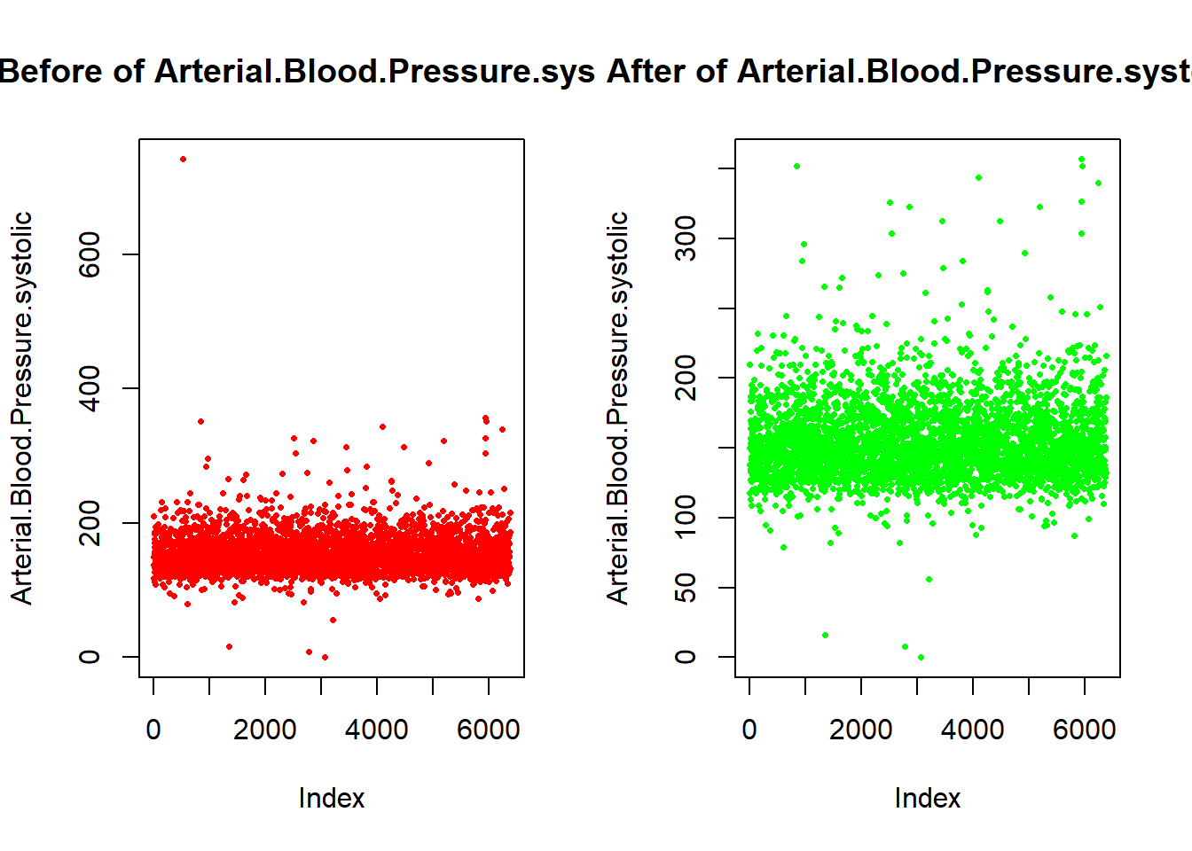
How was the limit set to remove out-of-range values? And what did change?
The first step to have a good and clean dataset was setting the limits for the numerical variables.
It was done by researching theoretical normal values and the maximum and minimum practical values, in some cases with success, and in others without finding a concrete value.
The following approach was to set the limit by analyzing the scatter plots for each variable, and deciding the limits manually, considering the theory and the plausibility of the scale.
Obtaining as a result a better distribution for the variables, removing the extreme skewness from some of them and normalizing others.
Note: For this stage we did not remove any observation, just changed the value itself as NA, this to keep the highest amount of original information.

Slide 12
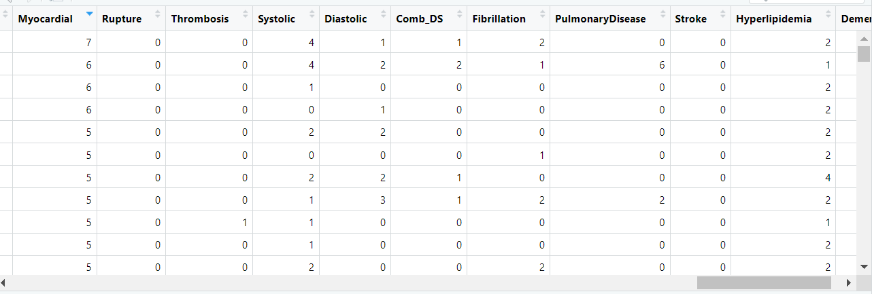
How we combined binary variables?
The binary variables in the dataset indicate various conditions marked for each patient, which we grouped by type to count the number of conditions each patient has.
For example, myocardial infarction includes 56 items or conditions. We combined these into a single variable, 'Myocardial,' which counts the number of such conditions per patient
With combination process we reduce size binary variables from 171 binary variables to 11 without losing information.

Slide 13
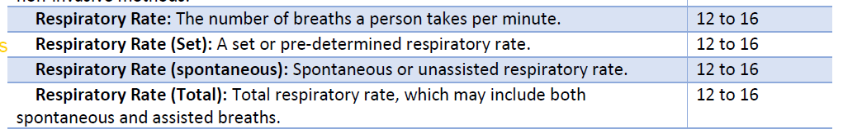
How to work with missing values in
numerical variables?
Numerical values are age, vital signs and laboratory test. In the description of variables, we notice that some variables are measuring the same thing under the same scale. Therefore, to reduce missing values we combinate results of alike variables.
For example, respiratory rate is measured 4 times. However, one the variables has an almost 99.7% complete value while the other ones has 40%, 28% and 37%. These variables can be combined into 1 variables and have 100% of data with average of all measurements.

Slide 14
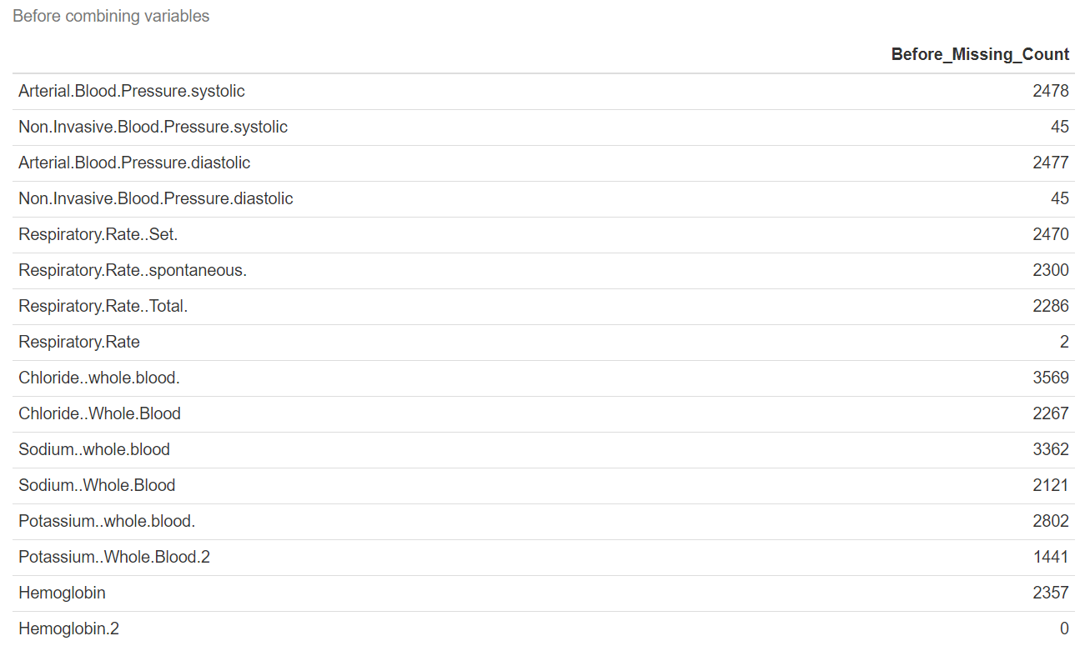
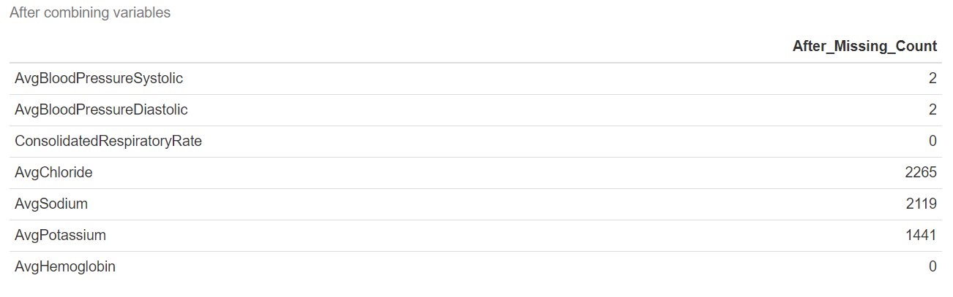
What was the result of combining numerical to reduce missing values?
After combining numerical variables that measure the same element, we were able to fill out missing values and reduce the number of variables.
Repeated measurements are no necessary, only one measure for feature will be needed for the model. So, an average of measure per patient keeps information allowed us to have fewer missing values.

Slide 15
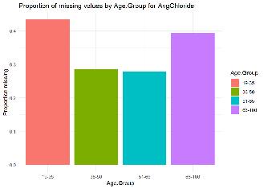
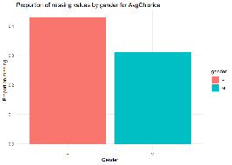
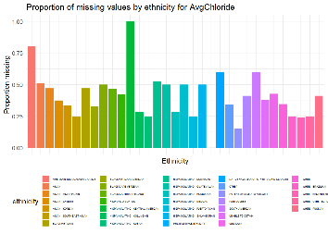
What treatment used for remaining missing values?
To address missing values, we examined the remaining information alongside demographic variables to identify any potential relationships; however, no strong relationship was established to justify demographic-based imputation directly.
For missingness by group, we plan to impute missing values based on similar cases by calculating the missing values for each variable across age, gender, and ethnicity.
Reasons for considering Age, Gender, and Ethnicity::
Age: Age is often a critical factor in healthcare and can influence health indicators.
Gender: Certain conditions or tests may be more prevalent or relevant for one gender over the other.
Ethnicity: Ethnicity is associated with various health factors and medical conditions, which may affect the presence or absence of certain variables in the dataset.
For few remain missing values where no pattern was not found we prefer to drop observations than to fill them without any valid logic.

Slide 16
Conclusions
Understanding variables and reviewing related information is essential for effectively working with data.
Three groups of variables were identified: numerical variables for vital signs, numerical variables for laboratory tests, and binary variables for diagnoses.
Identifying variables that measure the same concept on the same scale is crucial for filling in missing values among numerical variables. However, some missing values may remain, and if no logical method is applicable, it’s often better to drop these cases rather than imputing without clear criteria.
Combining variables across different groups of medical conditions helps consolidate information, as the number of marked conditions within each group can serve as an indicator of patient risk.
The final output is a clean dataset with no missing values, containing 3,406 observations and 34 variables.

Slide 17
Appendix

Slide 18
Relations between numerical variables - Correlation
We can see in darker green most strong correlations, positive and negative

Slide 19
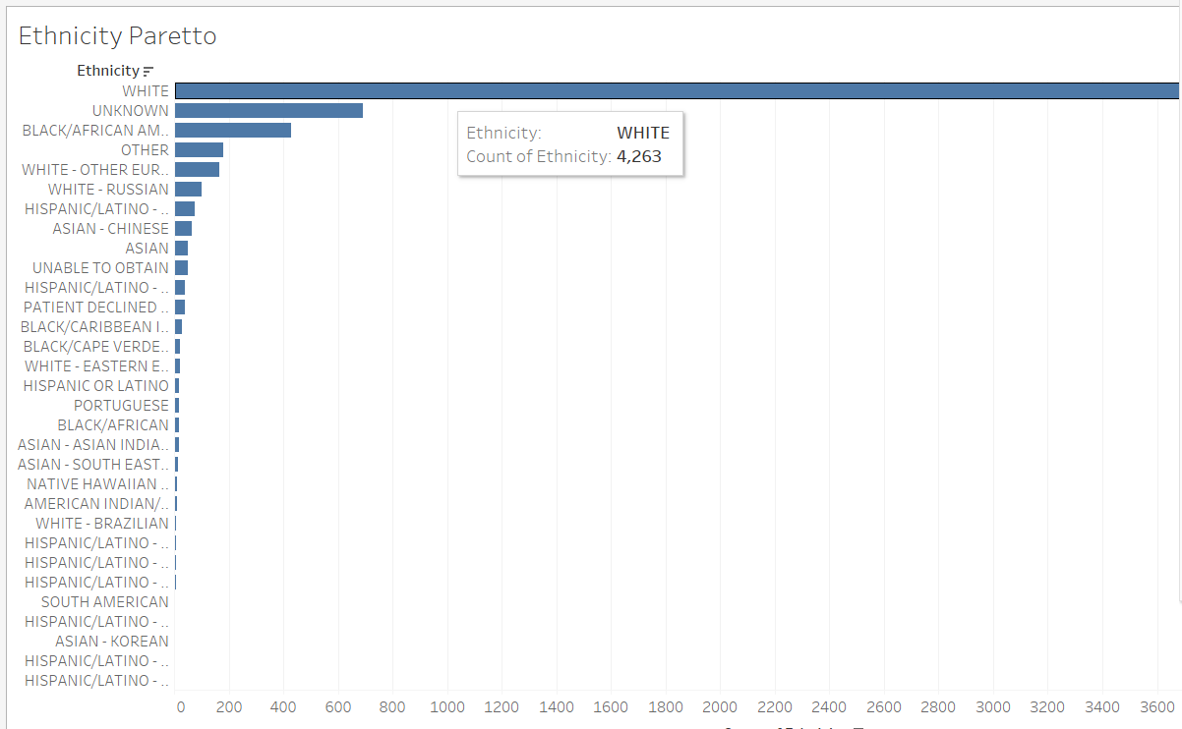

Slide 20
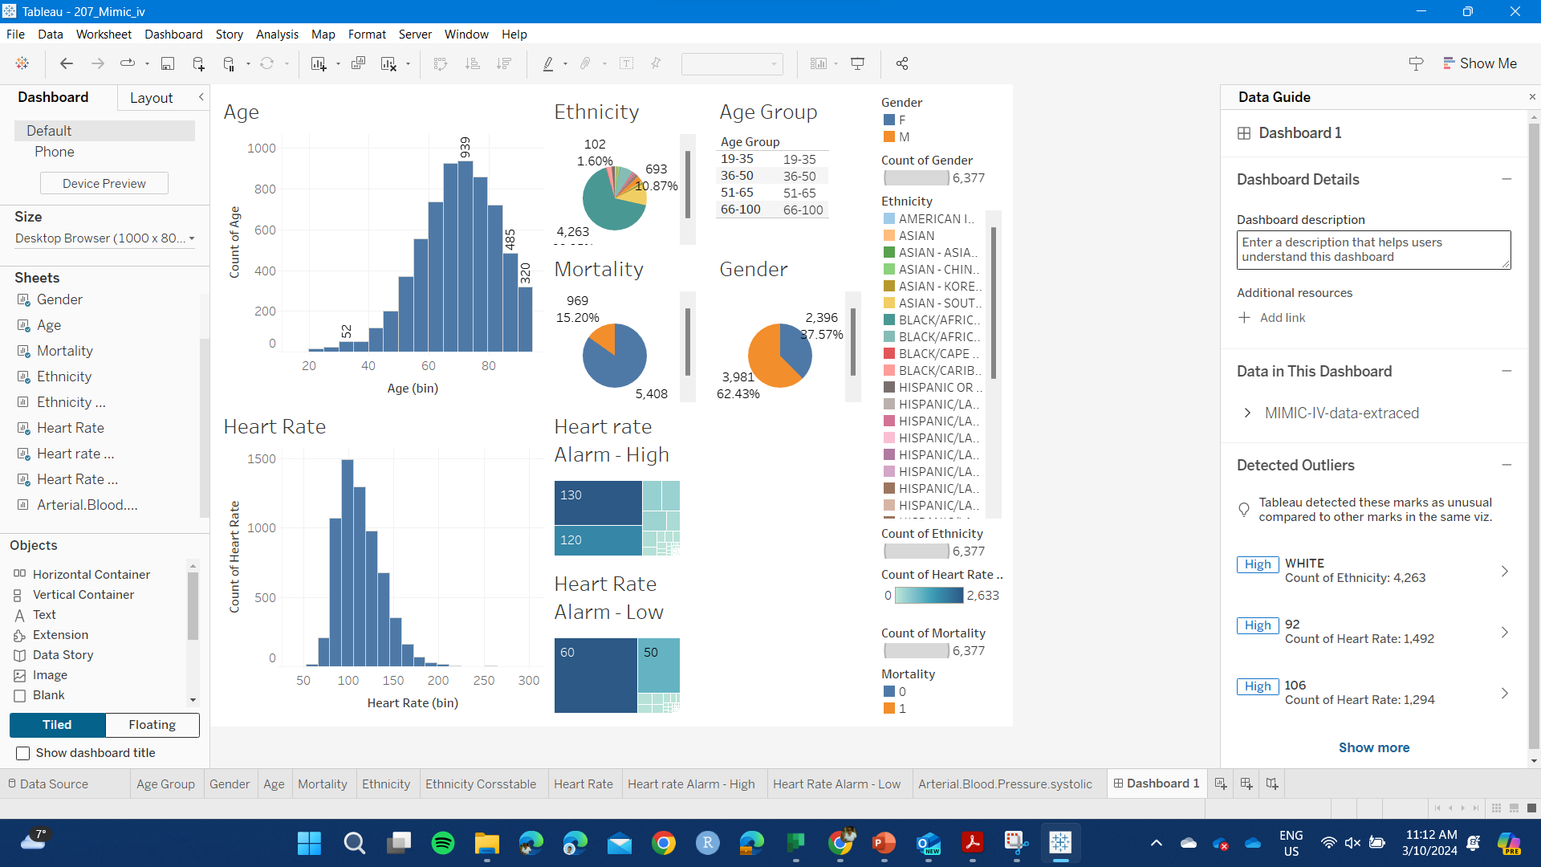
Relations between variables.
In a table, we can organize and group data by variable type to facilitate data analysis.

Slide 21
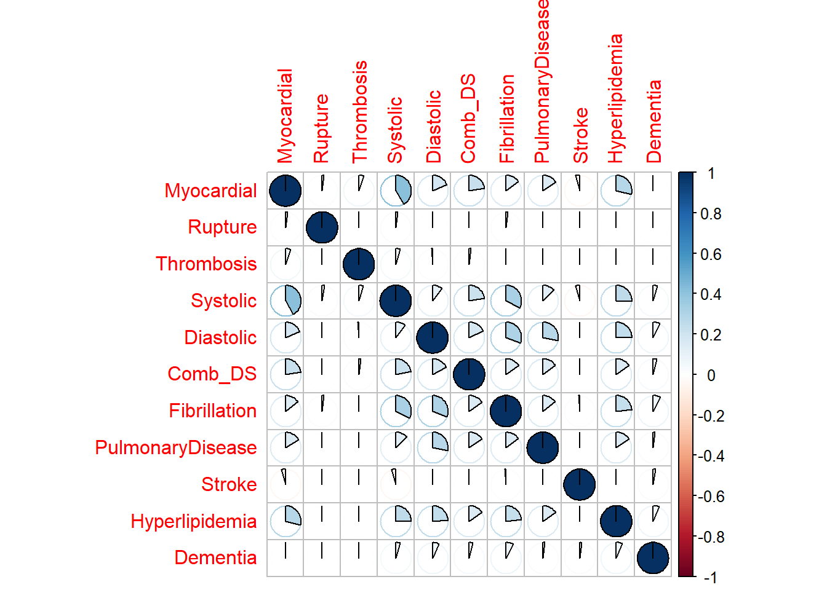
Correlation between diagnoses/binary groups

